Slide 1

POLLS MANAGEMENT
Group No:- 13
Group Members:- 1. Prithviraj Sunil Patil (27)
2. Shubham Jagdish Trivedi (42)
3. Shubham Tedginkeri (39)
4. Jatin Tiwari (41)
Guided By:- Vrushali Thakur

Slide 2

INTRODUCTION-
Conventional voting accomplishes many of these goals - private polling stations enable citizens to cast their votes anonymously, election day scrutineers offer independent oversight, and paper-based ballots provide a verifiable outcome that can be re-counted if necessary.
Electronic voting, particularly remote from supervised polling stations, threatens the hard-fought secrecy which protects voters from peer pressure and bullying. By breaking the secrecy of the ballot. Electronic voting is a hard computer science problem. The software needs to be able to authenticate voters are being real voters.

Slide 3

PROBLEM STATEMENT-
Why This Topic-
The Internet voting system tends to maximize user participation, by allowing them to vote from anywhere.
It is more secure than a manual election.
It provides quick and accurate results.
It is much more cheaper than the traditional election system.
A large number of response compared to manual election.
The process of online poll is easier than manual election

Slide 4

IMPLEMENTATION-
Software Requirement’s
Windows 7/8/10 Operating System
Core PYTHON Programming
PyCharm IDE for Front-End
XAMPP for Back-End

Slide 5

FORM’S DETAILS
Registration page
Login page
Admin login
Contact Us page
Choose a candidate
Thankyou page
Admin work-
Notify User
Winner
Add a Candidate

Slide 6

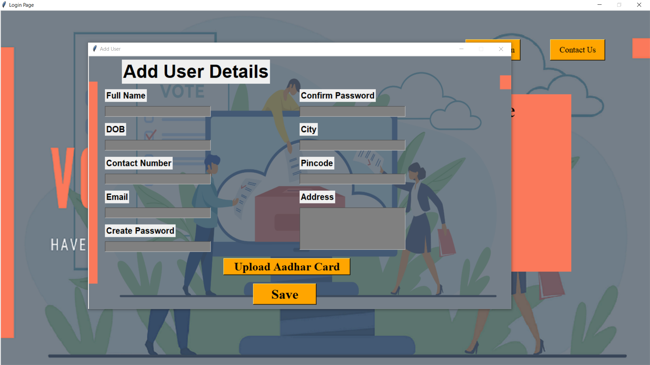
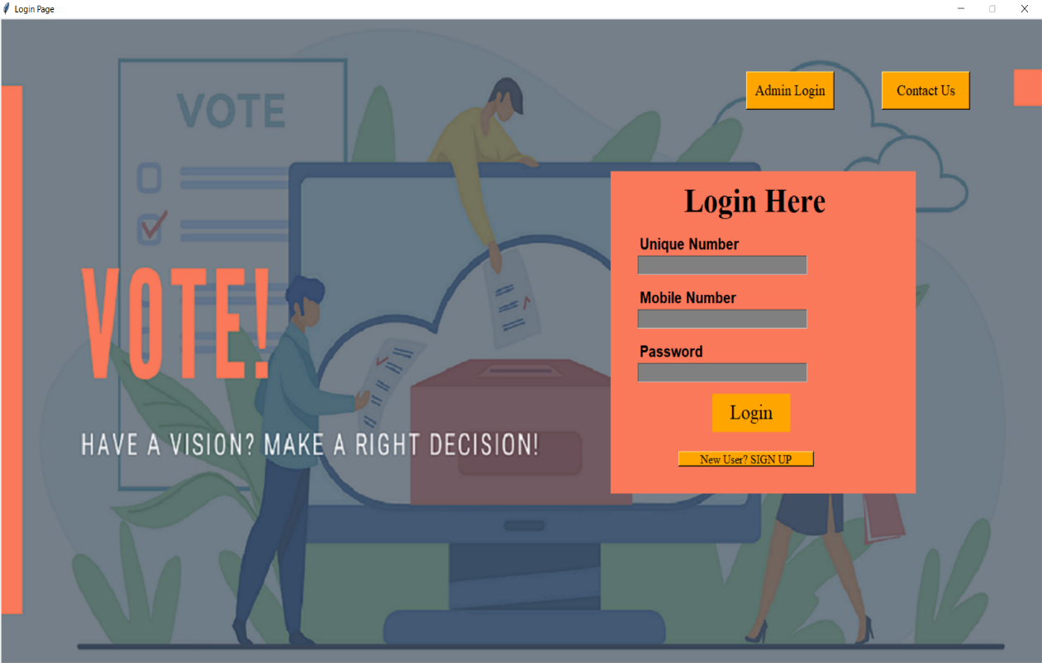
Registration page
Login page

Slide 7

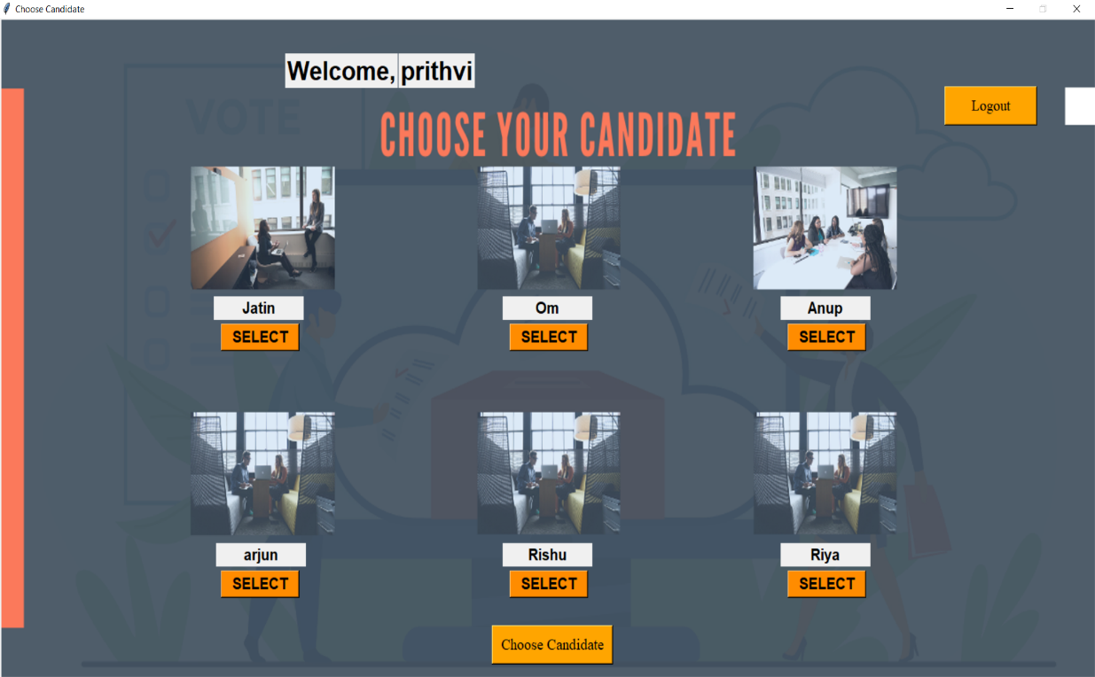

Choose a Candidate
Thankyou page

Slide 8

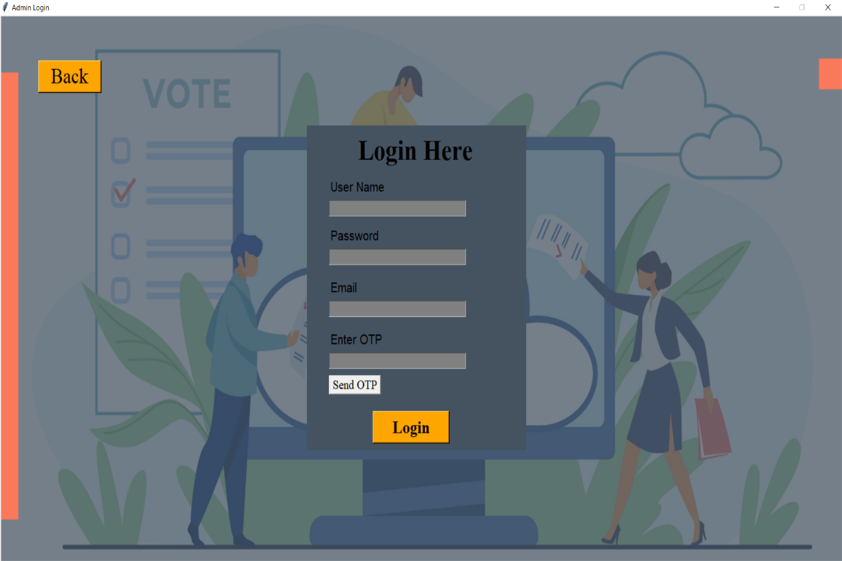
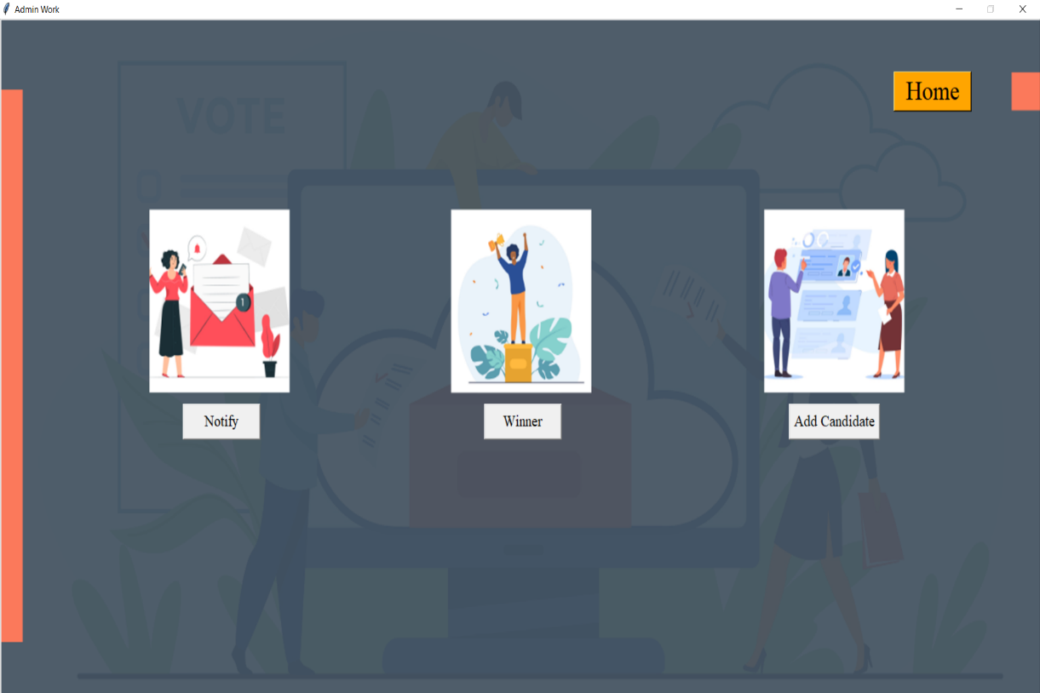
Admin Login
Admin Work

Slide 9

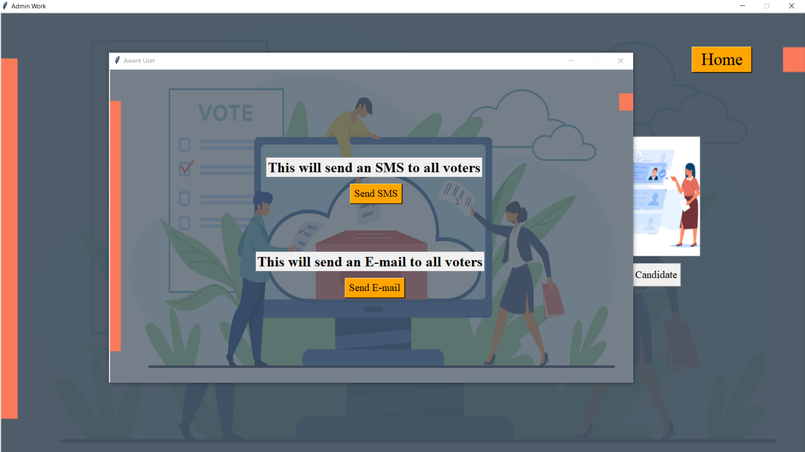
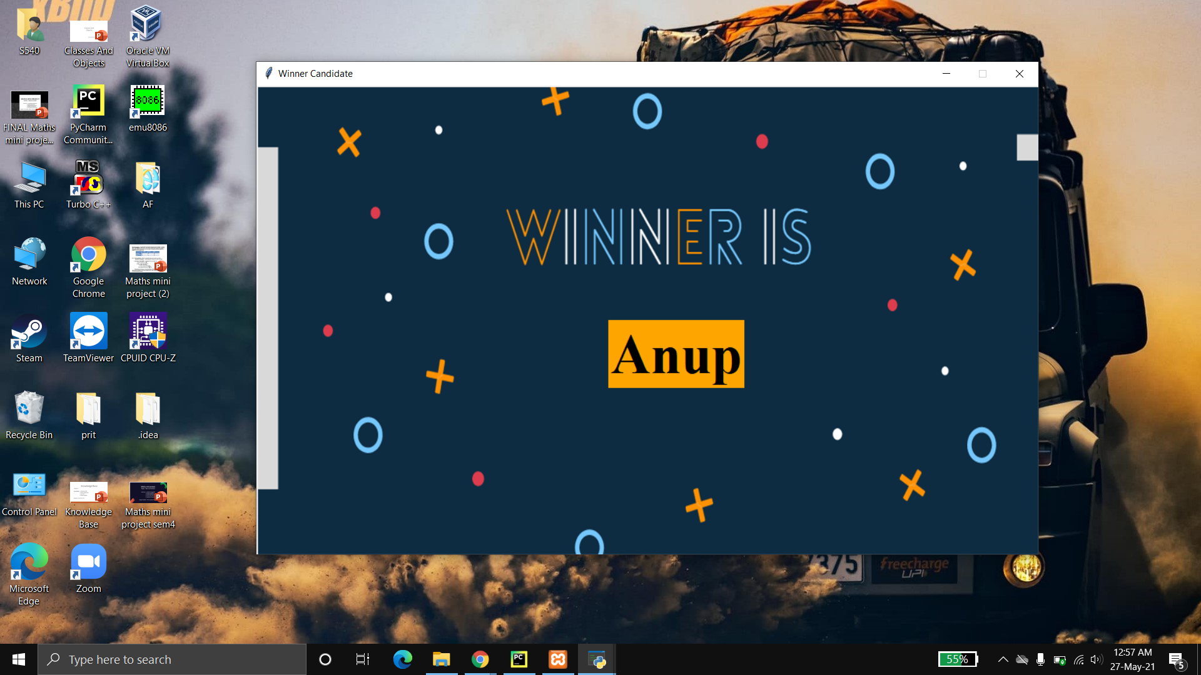
Notify
Winner

Slide 10
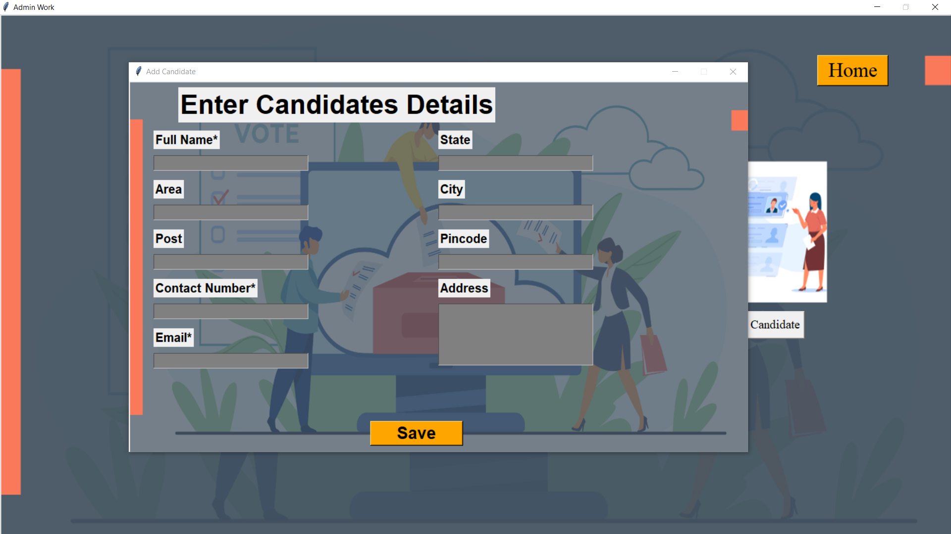

Add a Candidate
Contact Us

Slide 11

THANKYOU!!

